Slide 1
GAN (Generative Adversarial Networks)
This is type of neural network architecture consisting of two components: a generator network and a discriminator network.
The basic idea behind GANs is to have the two networks compete with each other, hence the name "adversarial".
The generator network is responsible for generating synthetic data, while the discriminator network tries to distinguish between the generated data and real data.

Slide 2
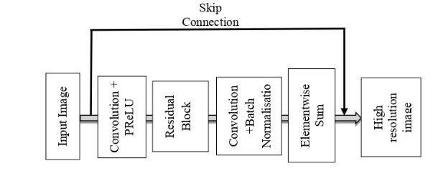
Generator Network

Slide 3
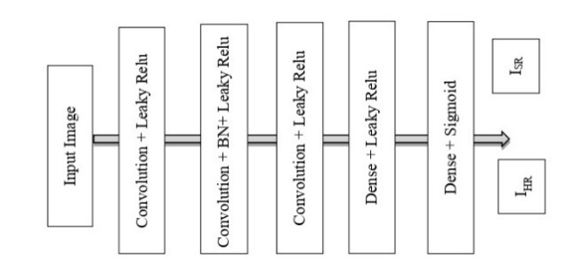
Discriminator

Slide 4
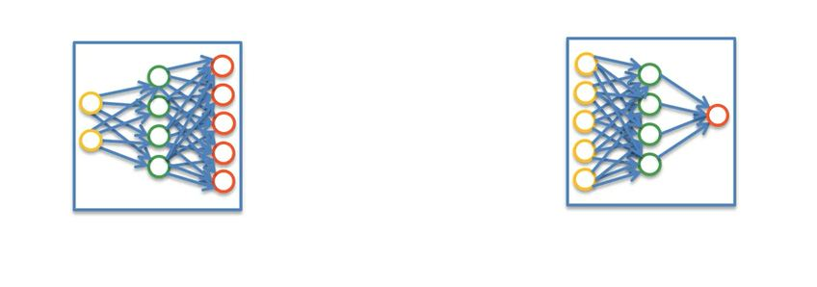
GAN, has two Components …
G and D

Slide 5
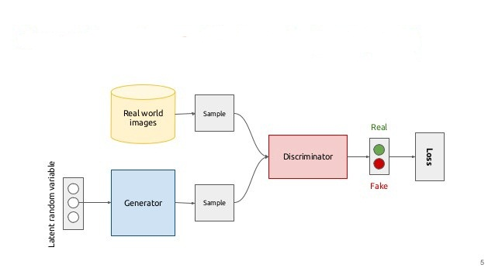
GAN, Architecture and Working

Slide 6
Mathematical expression of GAN
The mathematical expression for a GAN network can be broken down into the generator network and the discriminator network.
Generator Network:
The generator network takes a random noise vector z and generates a synthetic data sample x. The mathematical expression for the generator network can be written as:
G(z; θg) → x
where G is the generator function, z is the noise vector, and θg represents the parameters of the generator network.

Slide 7
Cont…
Discriminator Network:
The discriminator network takes a data sample x and returns a scalar value D(x), which represents the probability that the sample x comes from the real data distribution. The mathematical expression for the discriminator network can be written as:
D(x; θd) → [0, 1]
where D is the discriminator function, x is the data sample, and θd represents the parameters of the discriminator network. The output of the discriminator is constrained to the range [0, 1] using a sigmoid activation function.

Slide 8
Cont…
The objective of the GAN training is to find the optimal parameters θg and θd that minimize the following objective function:
min GmaxD E[x∼pdata(x)][log D(x)] +
E[z∼ pz(z)][log(1 - D(G(z)))]
where pdata(x) represents the real data distribution, pz(z) represents the noise distribution, and the objective function is a minimax game between the generator and discriminator networks.

Slide 9
Cont…
The first term of the objective function represents the discriminator's loss, which is the negative log-likelihood of the real data.
The second term represents the generator's loss, which is the negative log-likelihood of the generated data.
The generator tries to generate samples that fool the discriminator, while the discriminator tries to distinguish between the generated and real data samples.

Slide 10
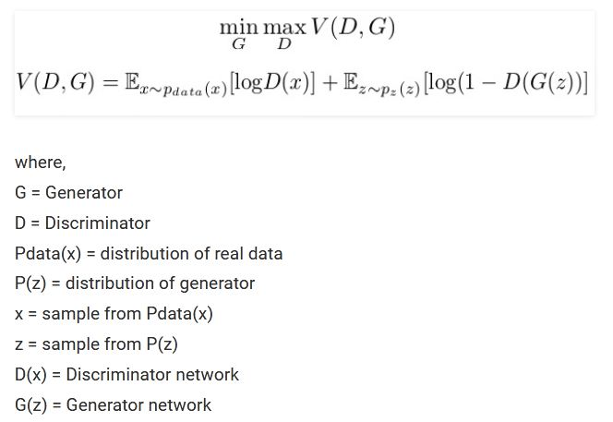
Loss function of GAN

Slide 11
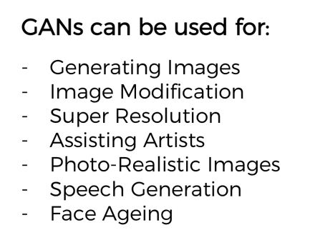
Application of GAN

Slide 12
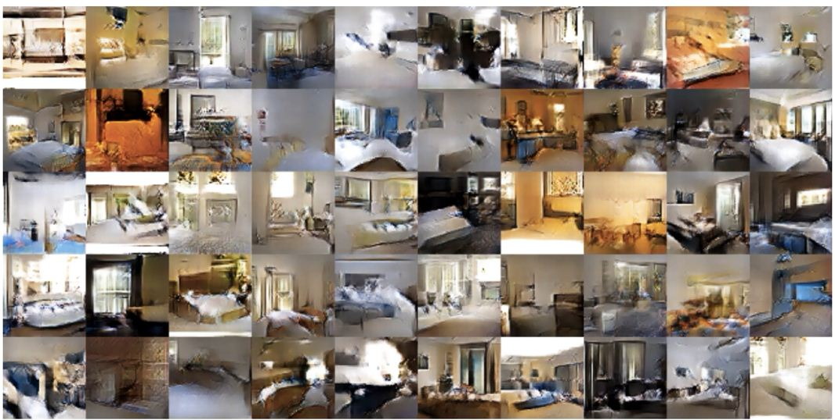
Application of GAN

Slide 13
Types of GAN:
Vanila GAN
Conditional GANs (CGAN)
Deep Convolutional GAN
Cycle GAN

Slide 14
Cont…
Vanilla GAN
This is the basic GAN architecture, which consists of a generator and a discriminator network. The generator network takes a random noise vector as input and generates synthetic data, while the discriminator network tries to distinguish between the generated data and real data.

Slide 15
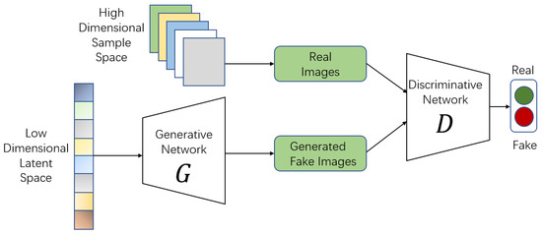

Slide 16
Cont…
Conditional GAN
This type of GAN is similar to the vanilla GAN, but it takes additional information as input, such as labels or other forms of conditioning variables. This allows the generator to generate data that is conditioned on certain inputs.

Slide 17
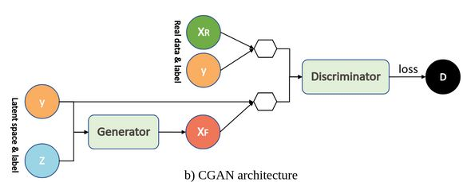

Slide 18
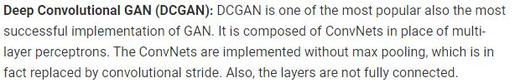
Deep Convolutional GAN

Slide 19
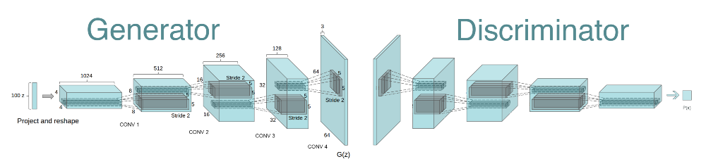
Cont…

Slide 20
Cont…
CycleGAN
This is a type of GAN that is used for image-to-image translation tasks. It consists of two generator networks and two discriminator networks.
The generator networks are responsible for transforming an image from one domain to another, while the discriminator networks try to distinguish between the generated image and real image.

Slide 21
Assignments
Architecture of Generative Adv. Network.
Architecture of Cycle GAN, CGAN, and DCGAN.
Difference between All types of Gan.
Experiment on Autoencoder.

Slide 22
An Overview of Deep Belief Network (DBN) in Deep Learning
A Deep Belief Network (DBN) is a sophisticated generative model that employs a deep architecture. In this article, we are going to learn all about it. After reading this article, you will have a better understanding of what a Deep Belief Network is, how it works, where to use it, and how to code your own Deep Belief Network.

Slide 23
What is a Deep Belief Network?
We create Deep Belief Networks (DBNs) to address issues with classic neural networks in deep layered networks.
For example – slow learning, becoming stuck in local minima owing to poor parameter selection, and requiring a large number of training datasets.
Several layers of stochastic latent variables make a DBN. Binary latent variables that are often known as feature detectors or hidden units are binary variables.
DBN is a hybrid generative graphical model. The top two layers have no direction. The layers above have direct links to lower layers.
DBN is an algorithm for unsupervised probabilistic deep learning.

Slide 24
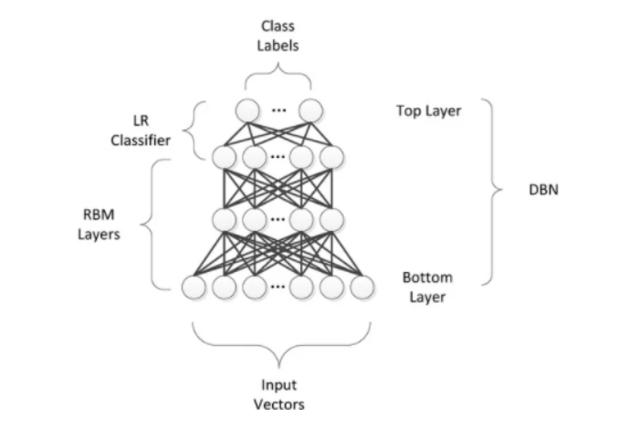

Slide 25
Deep Belief Networks are machine learning algorithm that resembles deep neural network but are not the same. These are feedforward neural networks with a deep architecture, i.e., having many hidden layers. Simple, unsupervised networks like restricted Boltzmann machines- RBMs or autoencoders make DBNs, with the hidden layer of each sub-network serving as the visible layer for the next layer.

Slide 26
How did Deep Belief Neural Networks Evolve?
We employ Perceptron in the First Generation of neural networks to identify a certain object or anything else by considering the weight. However, Perceptron may be beneficial for basic technology only, but not for sophisticated technology. To address these problems, the Second Generation of Neural Networks introduced the notion of Backpropagation, which compares the received output to the desired output and reduces the error value to zero. Then came directed acyclic graphs known as belief networks, which aided in the solution of inference and learning problems. Then, we’ll use Deep Belief Networks to help construct unbiased values that we can store in leaf nodes.

Slide 27
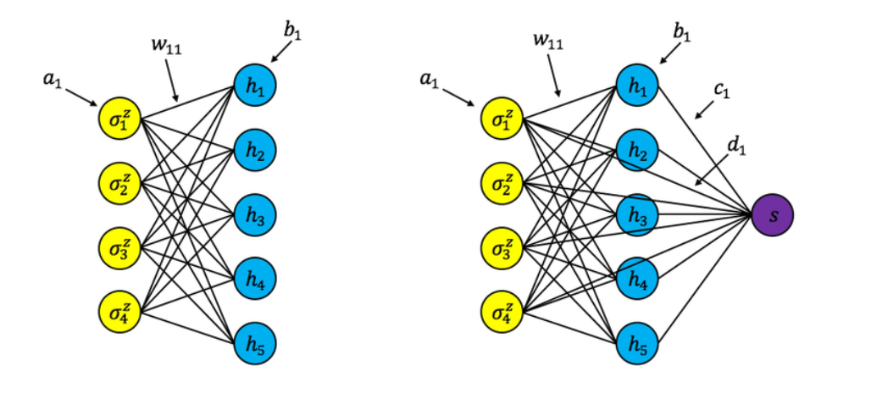
A Restricted Boltzmann Machine (RBM) is a type of generative stochastic artificial neural network that can learn a probability distribution from its inputs. Deep learning networks can also use RBM. Deep belief networks, in particular, can be created by “stacking” RBMs and fine-tuning the resulting deep network via gradient descent and backpropagation.

Slide 28
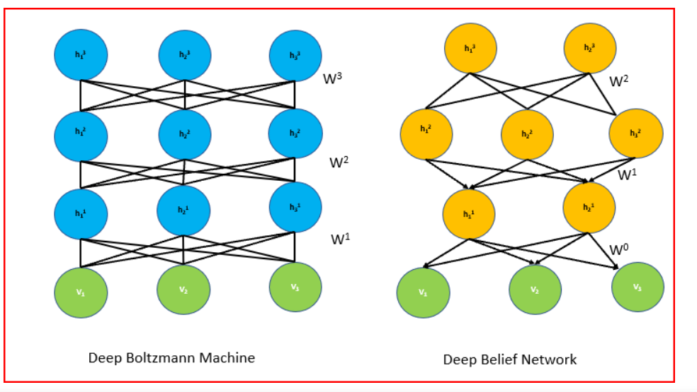
The Architecture of DBN
A series of constrained Boltzmann machines connected in a specific order make a Deep Belief Network. We supplement the result of the “output” layer of the Boltzmann machine as input to the next Boltzmann machine consecutively. Then we’ll train it until its convergence and apply the same until the completion of the whole network.

Slide 29
The undirected and symmetric connections between the top two levels of DBN form associative memory.
The arrows pointing toward the layer closest to the data point to the relationships between all lower layers. Directed acyclic connections in the lower layers translate associative memory to observable variables.
The lowest layer of visible units receives the input data. We can use Binary or actual data as input. Like Restricted Boltzmann Machine (RBM), there are no intralayer connections. The hidden units represent features that encapsulate the data’s correlations.
A matrix of symmetrical weights W connects two layers. We’ll link every unit in each layer to every other unit in the layer above it.

Slide 30
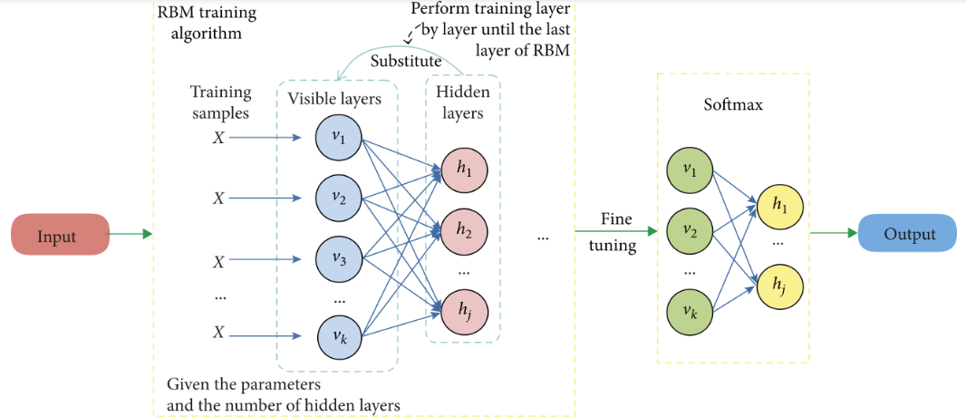
How does DBN work?
The first stage is to train a property layer that can directly gain input signals from pixels. In an alternate retired subcaste, learn the features of the preliminarily attained features by treating the values of this subcaste as pixels. The lower bound on the log-liability of the training data set improves every time a fresh subcaste of parcels or features that we add to the network.

Slide 31
Deep Belief Network’s operational pipeline is as follows:
We’ll use the Greedy learning algorithm to pre-train DBN. For learning the top-down generative weights-the greedy learning method that employs a layer-by-layer approach. These generative weights determine the relationship between variables in one layer and variables in the layer above.
On the top two hidden layers, we run numerous steps of Gibbs sampling in DBN. The top two hidden layers define the RBM thus, this stage is effectively extracting a sample from it.
Then generate a sample from the visible units using a single pass of ancestral sampling through the rest of the model.
We’ll use a single bottom-up pass to infer the values of the latent variables in each layer. In the bottom layer, greedy pretraining begins with an observed data vector. It then oppositely fine-tunes the generative weights.

Slide 32
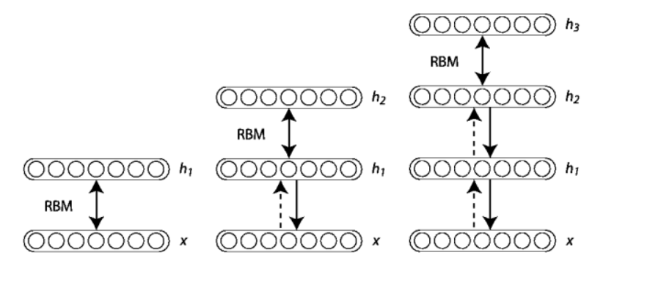
It’s necessary to remember that constructing a Deep Belief Network necessitates training each RBM layer. Initially, we’ll initiate the units and parameters for this purpose. In the Contrastive Divergence algorithm, there are two phases: positive and negative. We’ll calculate the binary states of the hidden layers in the positive phase by computing the probabilities of weights and visible units. It is known as the positive phase since it enhances the likelihood of the training data set. The negative phase reduces the likelihood of the model producing samples. To train a complete Deep Belief Network, we’ll employ the greedy learning technique. The greedy learning algorithm trains one RBM at a time until all of the RBMs are trained.

Slide 33
Applications
We employ deep belief networks in place of deep feedforward networks or even convolutional neural networks in more sophisticated setups. They have the benefit of being less computationally costly. computational complexity grows linearly with the number of layers, rather than exponentially as with feedforward neural networks) and is less susceptible to the vanishing gradients problem.
Applications of DBN are as follows:
Recognition of images.
Sequences of video.
Data on mocap.
Speech recognition.

Slide 34
Assignments
Deep Neural Network applications for multimedia.
Sequence and Streaming data.

